Slide 1
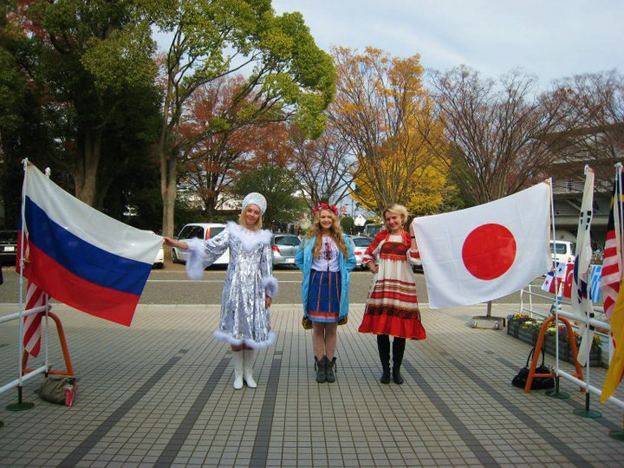
Option 1 Lending a helping hand Russians in Japan
Ekaterina Kuzmich
Anastasia Churazova

Slide 2
Embassy of the Russian Federation in Japan
Web-site: http://www.rusconsul.jp/
News and Events
Consular Services (help in getting Visa, conducting business in Japan etc.)
Other info (History of Russia-Japan Relations etc.)
Useful links
Etc.

Slide 3
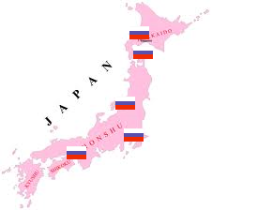
Location of Russian Consular Establishments in Japan
Consular Section of the Embassy of Russia in Japan - Minato-ku, Tokyo
Consulate-General of the Russian Federation –
-Hokkaido
(Sapporo and Hakodate)
-Osaka
-Niigata

Slide 4
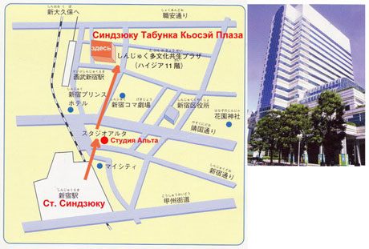
Russian Community in Japan
Russian Club in Tokyo
Founded in 1992 on the base of Russian Embassy in Japan.
Web-site: http://www.yaponist.com/indexj.htm
Location: Shinjuku, Tokyo

Slide 5
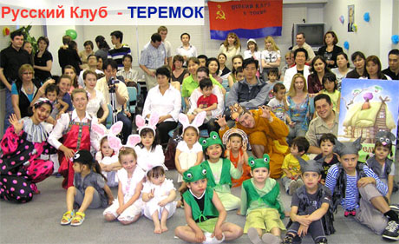
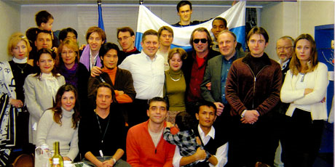
Activities of the club
Meetings every weekend
Russian/Japanese language classes
Sport events
Educational events for children

Slide 6
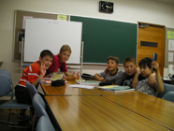
Education
Russian Embassy Secondary Education School - focused on teaching English (full-time) http://www.russchool.jp/hp/index.html
“Rosinka” - a school for children of Russian emigrants in Japan, focused on teaching Russian language/literature/culture (twice a week, in addition to a Japanese school) http://rosinkajp.com/index.html

Slide 7
Japan-Eurasia Society
Web-site: http://www.kt.rim.or.jp/~jes/
Offers Japanese language classes for Russian-speakers, various lectures in Russian and other useful services and info.

Slide 8
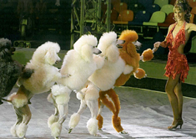
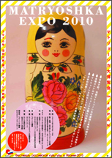
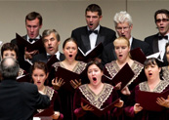
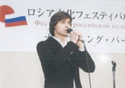
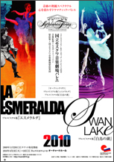
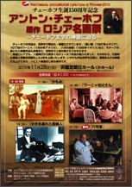
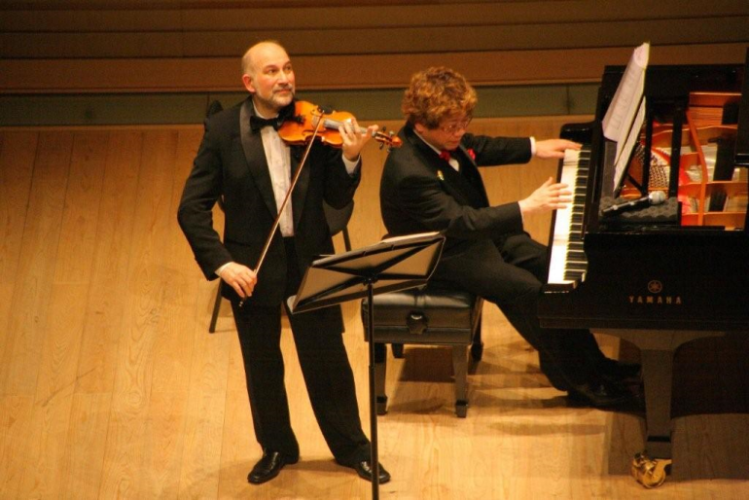
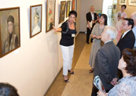
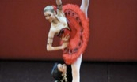
Cultural Activities
The Russian Culture Festival in Japan
Web-site: http://www.russian-festival.net/index.html
Held every year in Tokyo.

Slide 9
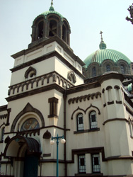
Religion
The Holy Resurrection Cathedral, commonly called Nikolai-do, in Surugadai, Kanda district, Tokyo, is the main cathedral of the Japanese Orthodox Church.
It was named after St. Nicholai, the Russian missionary who was responsible for establishing the Eastern Orthodox Church in Japan.
Services twice a day, in Japanese.

Slide 10
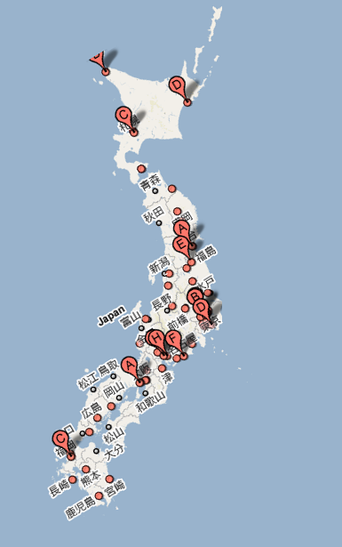
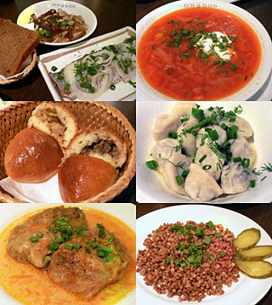
Russian Restaurants
Baikal (Roppongi)
Matoryosika (Shinjuku, Ebisu)
Samovar (Ikejiri-Ohashi)
Chaika (Takadanobaba)
Cafe Russia (Kichijoji)
Etc.
Online food store
Web-site: http://buratino-jp.com/

Slide 11
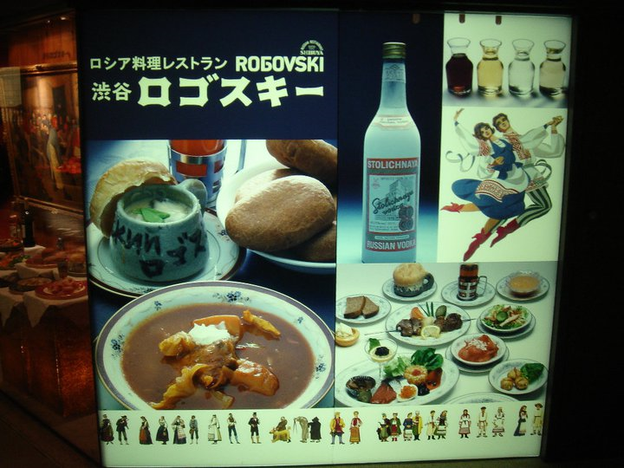
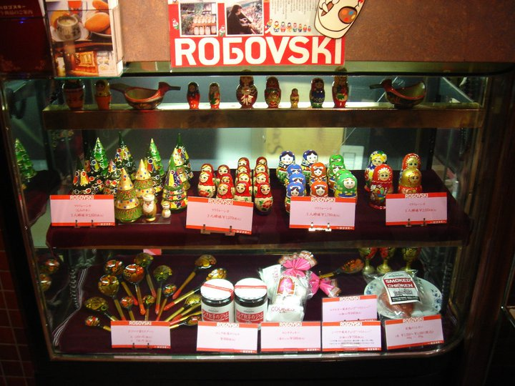
Rogovski
Location: Shibuya
Web-site: http://www.rogovski.co.jp/

Slide 12
Thank you!

